Slide 1
Overall sustainability impact of population trend: comparison between developed and developing countries. London Metropolitan University. September 18, 2023.
Samrat rai (21025221).

Slide 2
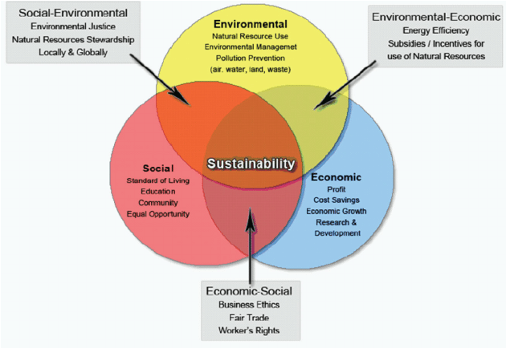
Background
Sustainable development aims to meet the present needs while securing future generations' ability to maintain sustainable lifestyles (Safdie, 2023).
Three spheres/pillars of sustainability.

Slide 3
Research Aim
Impact of Population Trend on Sustainability.
Environment
Economic
Social

Slide 4
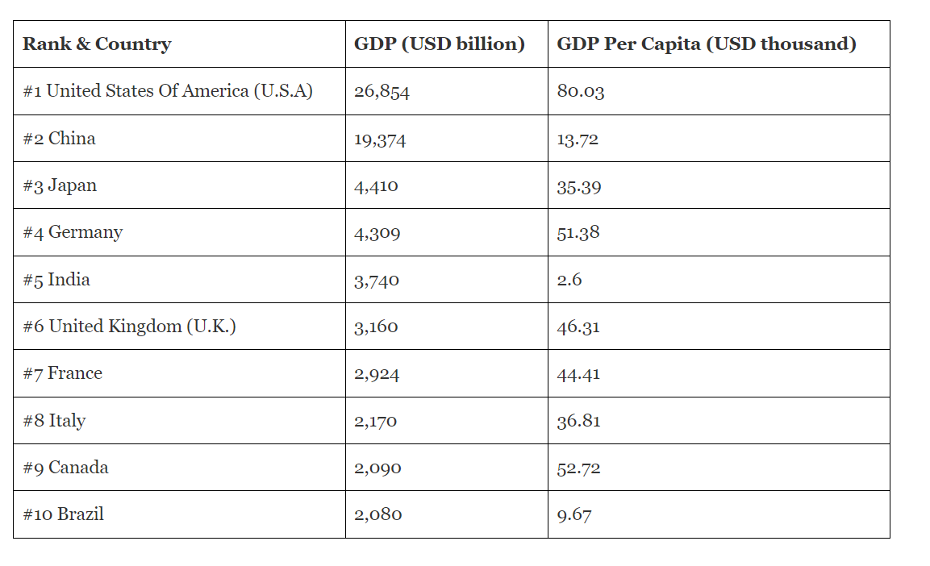
Hypothesis
Positive Impact on Economy.
Population is a Resource.
Example:
Source: Forbes (2023)

Slide 5
hypothesis
Negative Impact on Environment
Increased Demand (Energy, Resources, Services) = Increased CO2 Emissions.

Slide 6
Hypothesis
Mixed Social Impacts
Increased Services in an area e.g., social activities, and vibrant city life (Shah et al., 2016; Allard and Roth, 2010)
Increased Crime rate. (Lad Brook, 1998)

Slide 7
methods
Quantitative analysis- datasets.
Qualitative analysis-literature reviews.
Wordlbank.org
Google scholar.

Slide 8
Software’s used
Tableau
Jupiter notebook
Pandas library
For example: import pandas as pd. List function to store the range of columns which needed to be dropped.
Used the drop function to drop the selected range of columns.

Slide 9
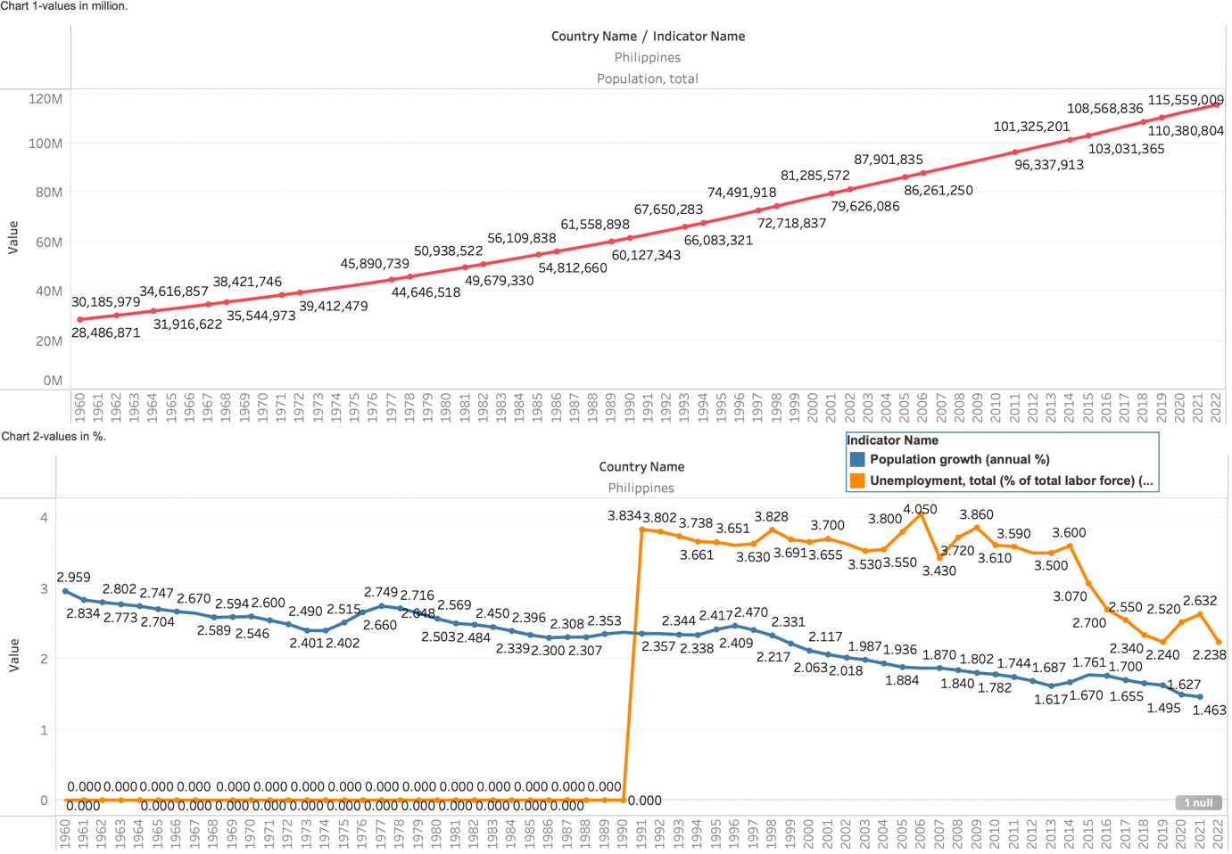
Philippine’s Findings(socio-economic)
The Annual Population growth rate positively impacts the unemployment rate as both decrease simultaneously from 1991 to 2021. So does the total population growth.
Created from Tableau & sourced from the World Bank (Unemployment, total (% of total labor force) (modeled ILO estimate), 2023).

Slide 10
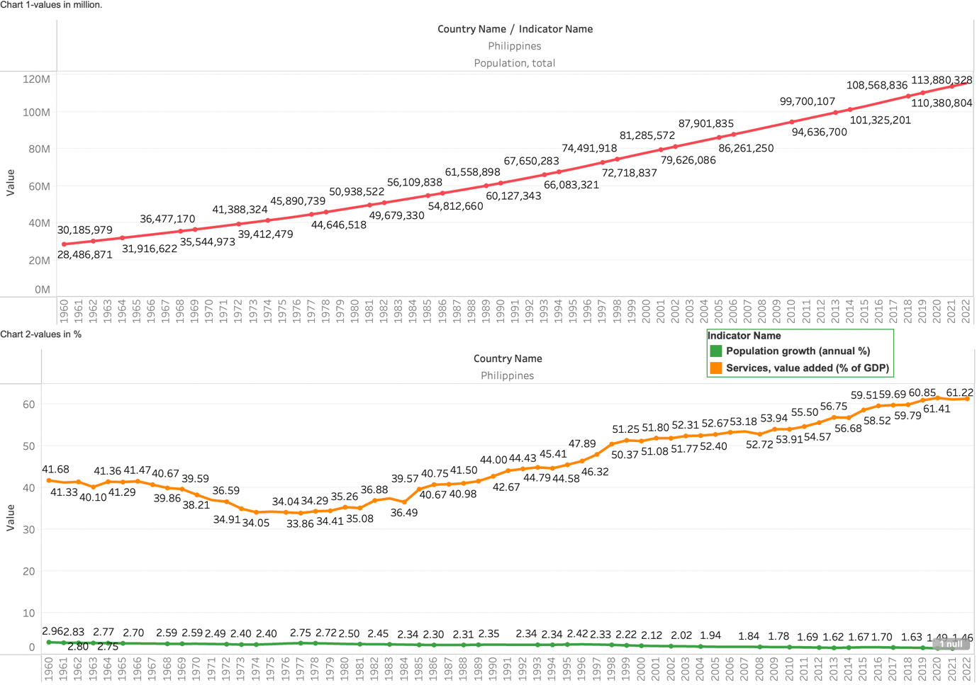
Philippine’s Findings(socio-economic)
A drop in Unemployment and growth in population has a positive impact on services as the value of the service has increased from 1985 to 2022.
Created from Tableau & sourced from the World Bank (Services, value added (% of GDP), 2023).

Slide 11
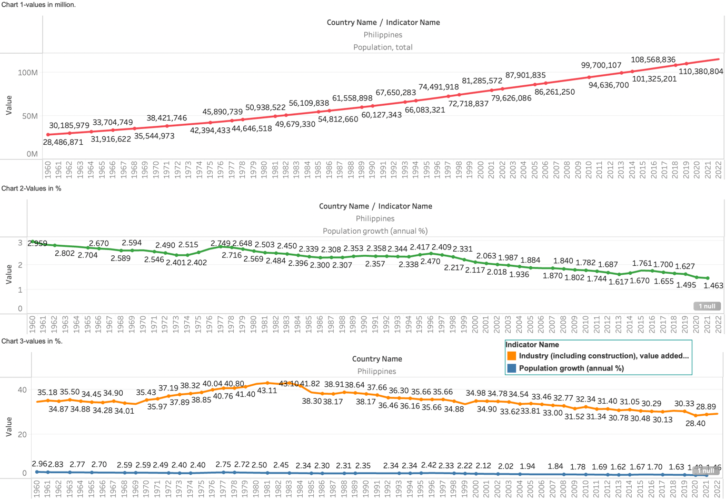
Philippine’s Findings(socio-economic)
Annual population growth has a positive correlation with industrial value.
when unemployment rate decreases the industry value also decreases.
Created from Tableau & sourced from the World Bank (Industry (including construction), value added (% of GDP), 2023).

Slide 12
External factors
One of the primary reasons for the downfall of industry value is that of Philippines’s export-oriented industrialisation (EOI) in the 1970s-1990s failed to take off due to its narrow program, which needed more focus on industrial upgrading and value-adding linkages with the domestic economy (Ofreneo, 2015).
The absence of systemic governance and policy coherence also contributed to the failure (Ofreneo, 2015).
E-trikes, jeepneys and herbal medicines can be innovative incentives towards a sustainable service economy.

Slide 13
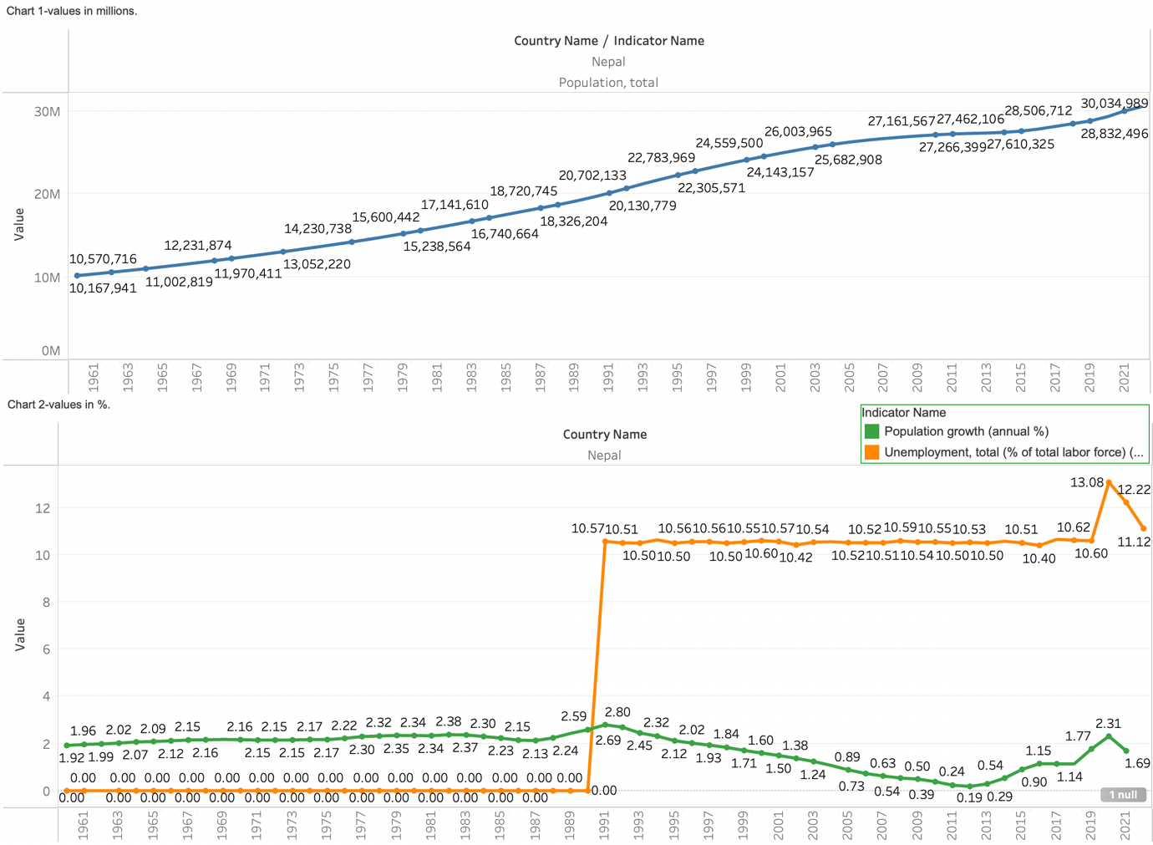
Nepal’s findings (socio-economic)
There is no correlation between population growth and unemployment, as the unemployment rate remains constant while the total population growth increases.
Created from Tableau & sourced from the World Bank (Unemployment, total (% of total labor force) (modeled ILO estimate), 2023).

Slide 14
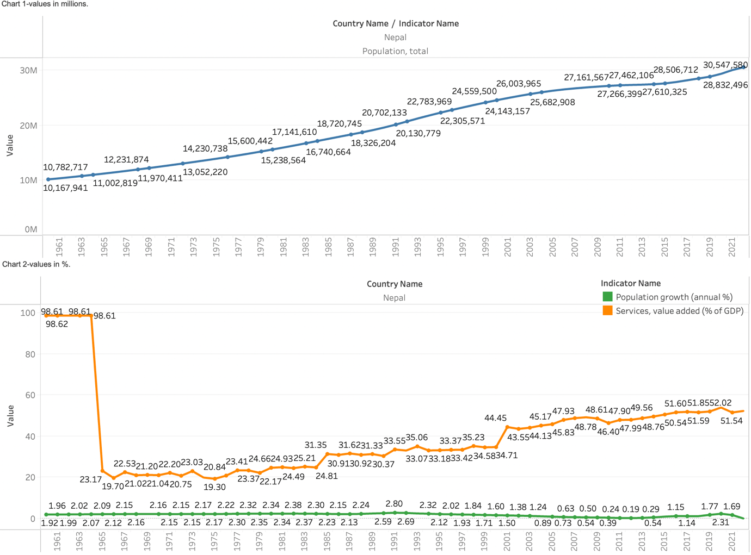
Nepal’s findings (socio-economic)
There is no correlation between unemployment and services; as services value increases, unemployment remains constant.
There is a positive correlation between population growth and services. As the population growth rate increases, the value of services also increases, implying that services play a more significant role in GDP
Created from Tableau & sourced from the World Bank (Services, value added (% of GDP), 2023).

Slide 15
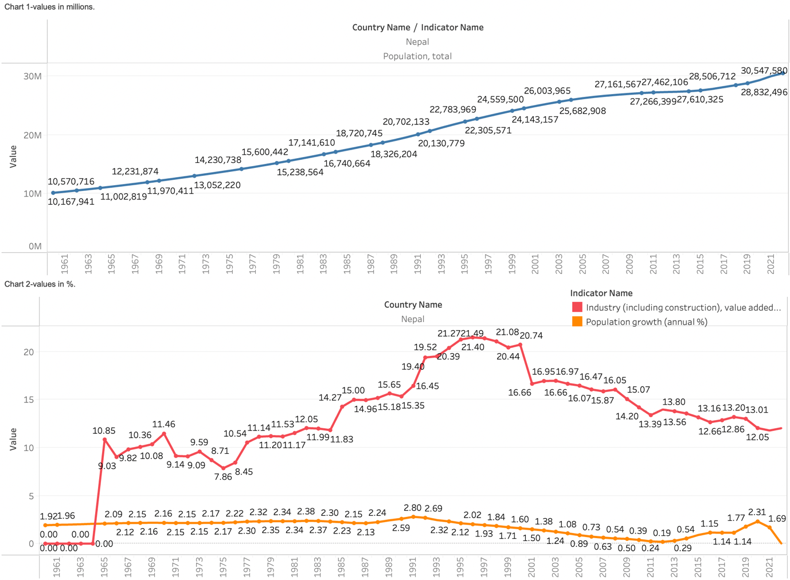
Nepal’s findings (socio-economic)
It has been observed that there is no correlation between the growth of the industry and the population, as the industry value has shown a fluctuation range of 7.85% to 21.49% from 1965 to 2021, while the population growth has remained stable. Similarly, unemployment has remained constant despite the fluctuations in industry value.
Created from Tableau & sourced from the World Bank (Industry (including construction), value added (% of GDP), 2023).

Slide 16
External factors
Nepal's industrial growth is hindered by inadequate infrastructure development and insufficient funding. To address this issue, the government needs to increase investments in new infrastructure development and maintain existing infrastructure (Collegenp, 2023).
Political disputes, lack of technical expertise, corruption, and the country's rugged terrain and complex geography have also impeded progress in the sector (Collegenp, 2023).
The service sector is essential in addressing Nepal's unemployment problem. Despite the lack of industries and unfavourable trade conditions that force many Nepalese to seek employment abroad, establishing private hospitals, restaurants, schools, colleges, banks, and hotels creates job opportunities that elevate individuals and the nation's economic status (Present State Of Service Sectors And Its Importance, 2020).

Slide 17
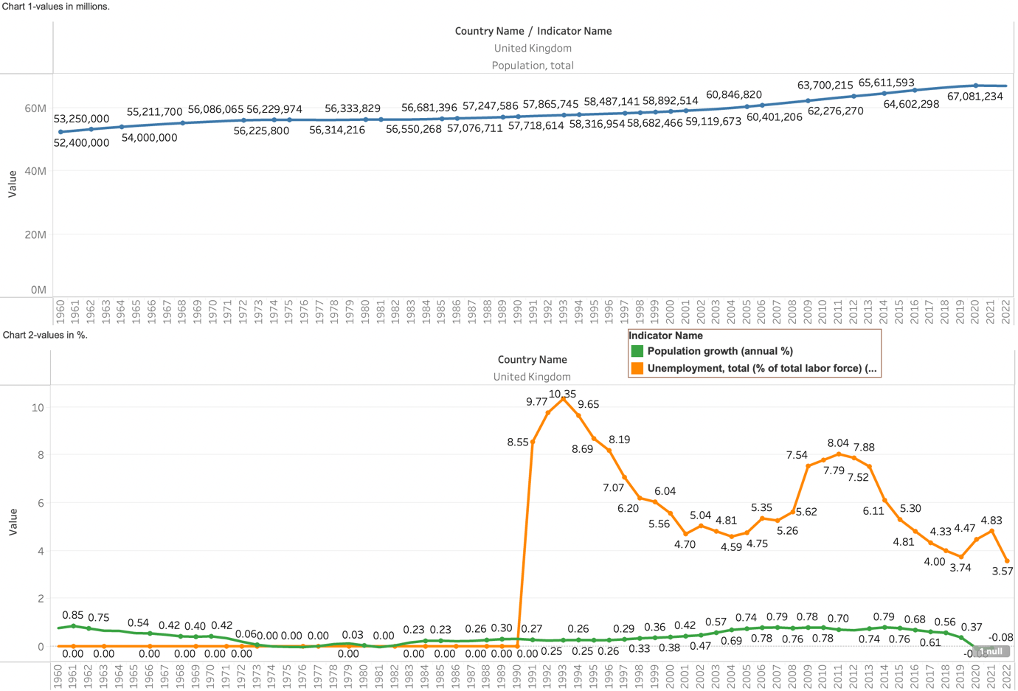
UK findings (socio-economic)
The population growth rate has no significant impact on the unemployment rate. As the annual population growth rate remains constant, the unemployment rate decreases.
Created from Tableau & sourced from the World Bank (Unemployment, total (% of total labor force) (modeled ILO estimate), 2023).

Slide 18
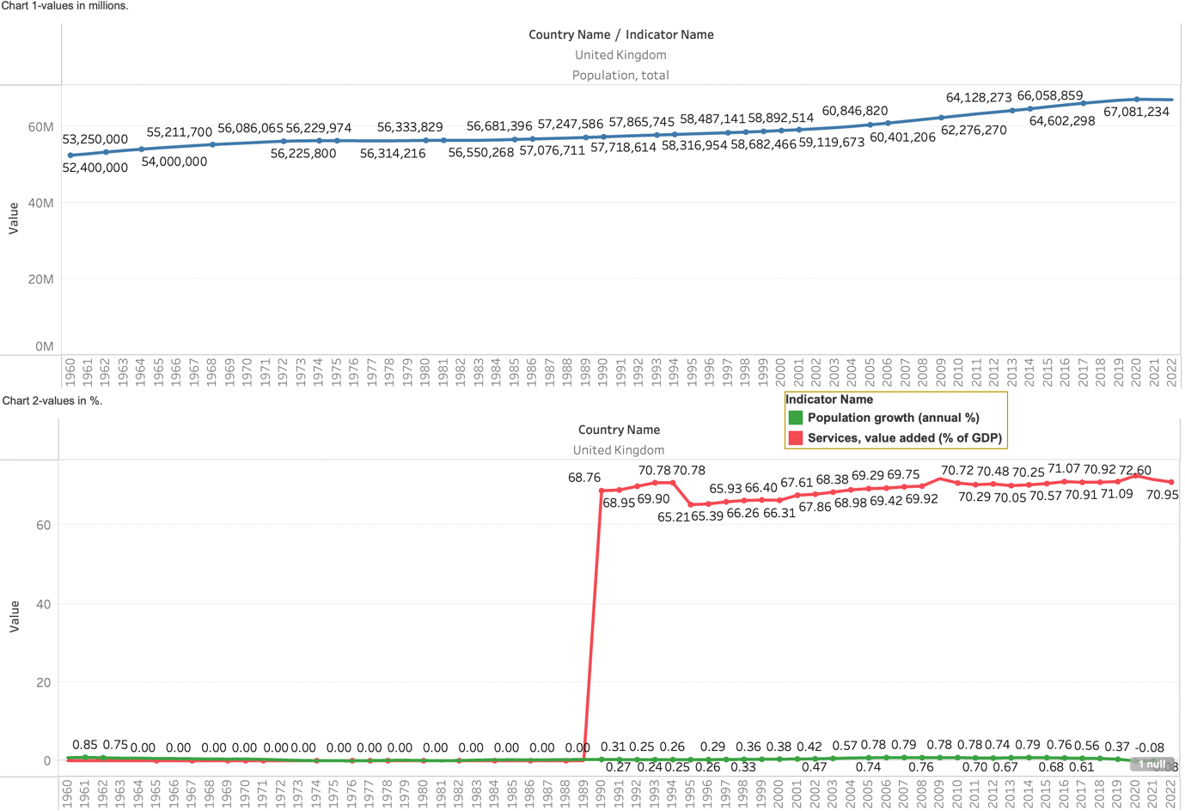
UK findings (socio-economic)
Unemployment and population growth have no significant impact on service value %, as the value of the service remains between 65-72% from 1990 to 2020 while the annual population growth rate remains constant. When the unemployment rate drops, the service value remains constant.
Created from Tableau & sourced from the World Bank (Services, value added (% of GDP), 2023).

Slide 19
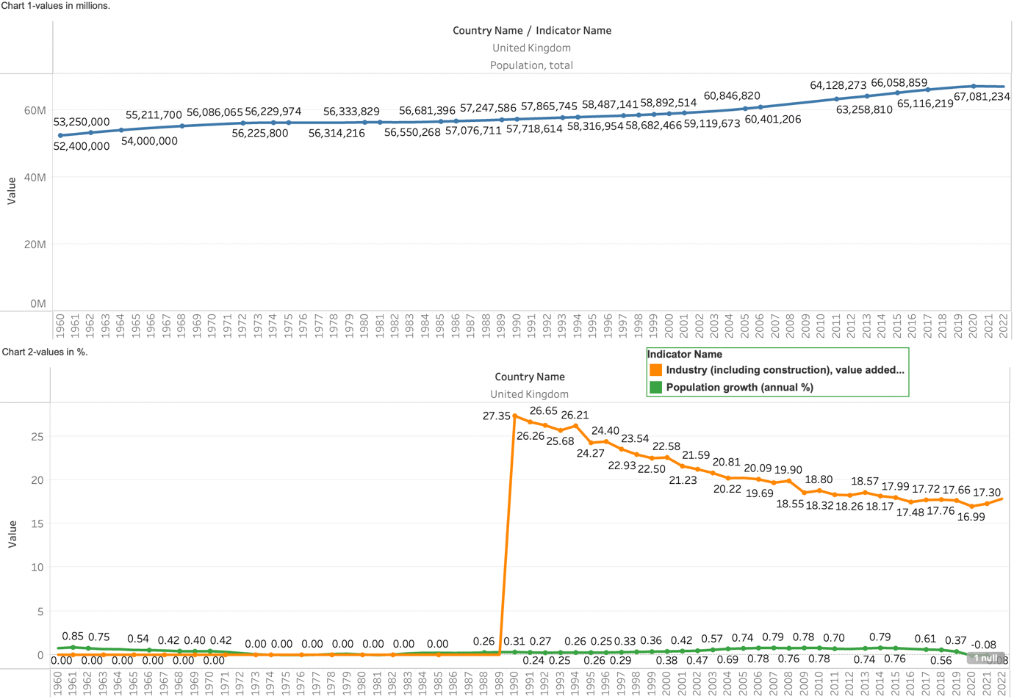
UK findings (socio-economic)
Unemployment and population growth do not significantly impact industry value %; as the unemployment rate decreases, the industry value decreases. As the population growth rate remains constant, the industry value decreases, which pertains to external factors playing a role in impacting industry value.
In the UK, like Nepal, other external factors impact the Socioeconomic status. Various online literature cites that different National and Firm policies play a much more significant impact on the socioeconomic sector in the UK (Cole, 2008; Johnson and Layard, 1986; Clasen, 2002).
Created from Tableau & sourced from the World Bank (Industry (including construction), value added (% of GDP), 2023).

Slide 20
External factors
Manufacturers reported declining production and sales due to high energy costs and the rising cost of living (Robinson, 2023).
The COVID-19 pandemic had varying effects on UK sales. Food and non-store retailers saw a £4 billion increase in sales (Panzone et al., 2021). In contrast, non-food stores and food and beverage serving services experienced a significant decline, with a £20 billion and £25 billion loss in turnover, respectively (Panzone et al., 2021).
The determining factor for employee satisfaction and retention is the organisational culture (Reidhead, 2020).
Master's fees are now closer to the maximum value of postgraduate loans, leaving little for living costs (House, 2020).

Slide 21
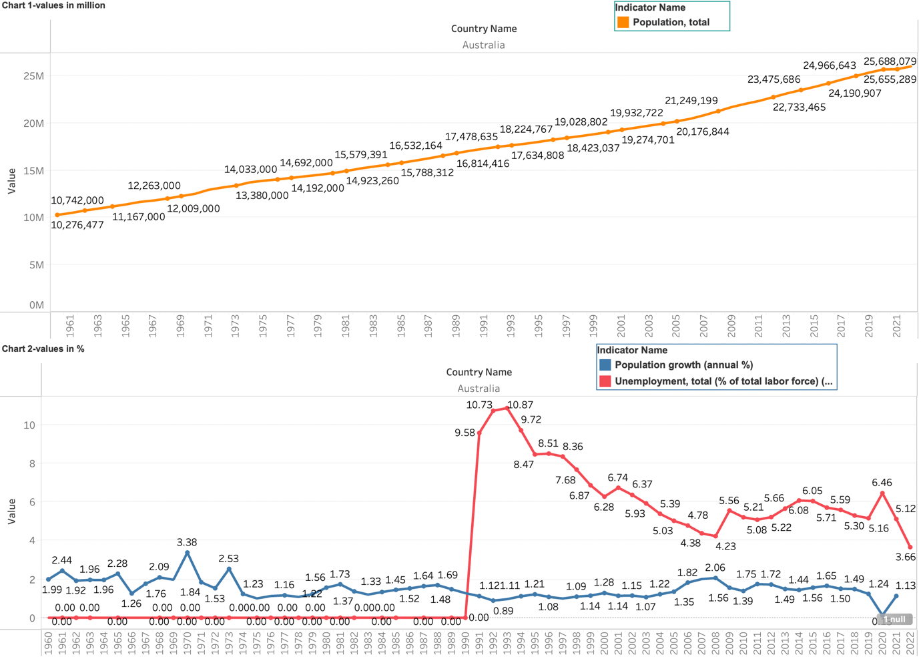
Australia findings (socio-economic)
Annual population growth % has no significant impact on unemployment % as it has been constant between 1990 and 2022, and the unemployment rate has dropped significantly. 10.8% in 1992 to 3.66% in 2022.
Created from Tableau & sourced from the World Bank (Unemployment, total (% of total labor force) (modeled ILO estimate), 2023).

Slide 22
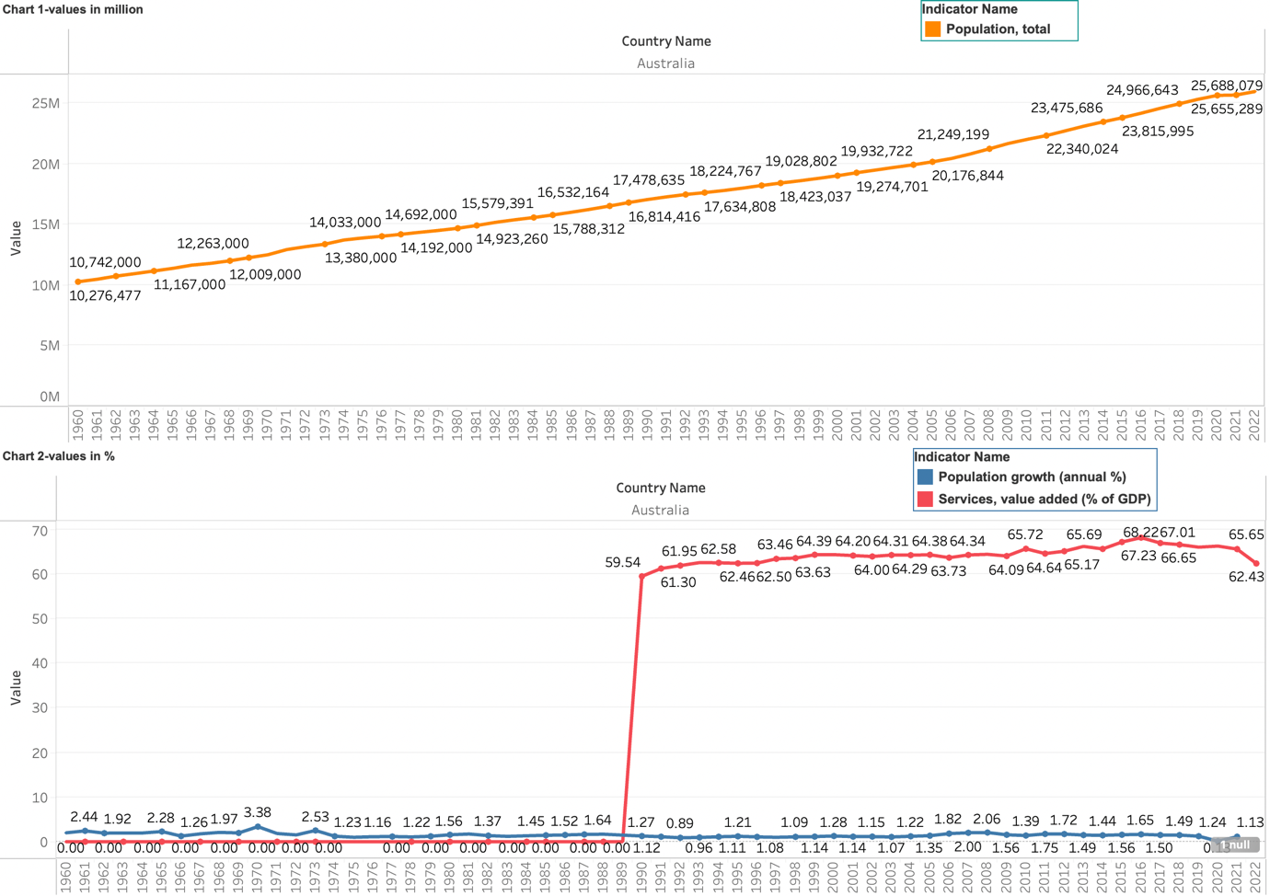
Australia findings (socio-economic)
The service sector’s fluctuating growth % from the low 60s to the high 60s from 1990 to 2022 indicates that population growth and unemployment decrease during the same period doesn’t significantly impact Australia's service sector.
Created from Tableau & sourced from the World Bank (Services, value added (% of GDP), 2023).

Slide 23
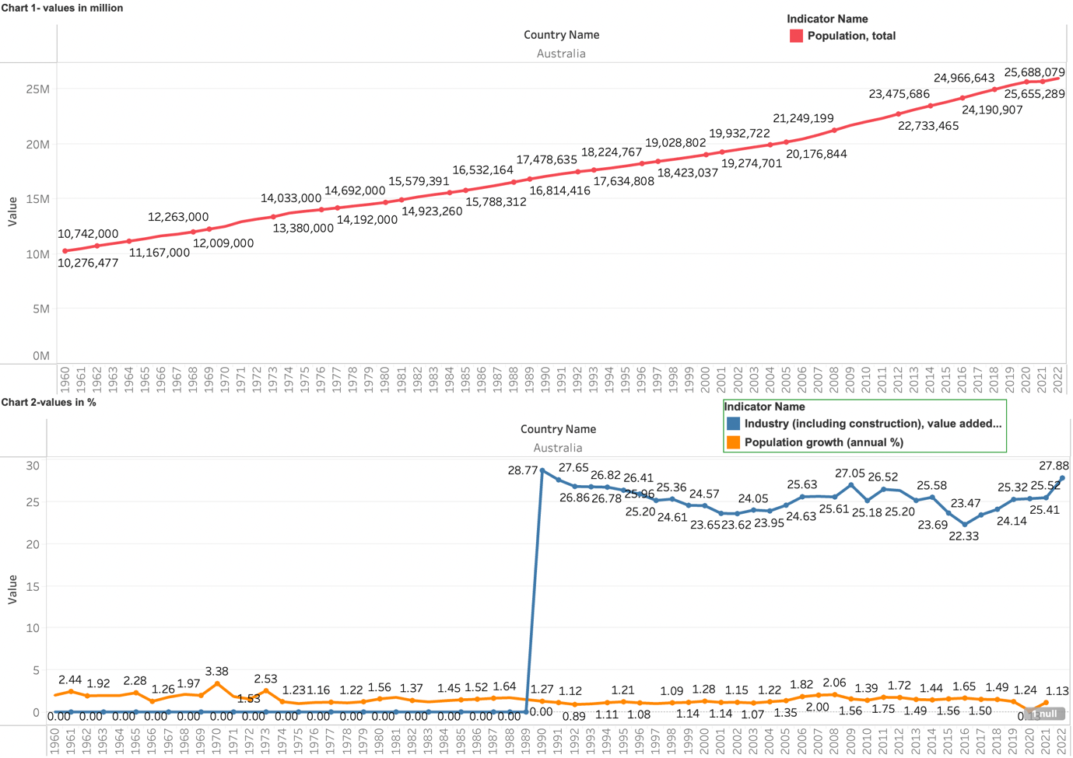
Australia findings (socio-economic)
A decrease in the Unemployment rate and an increase in population growth from 1990 to 2022 has no significant impact on industrial value % as it fluctuates from the high 20s to the low 20s in that same period.
Regarding socio-economic impact, the annual population growth rate has no significant effect on unemployment, service sector value & industrial sector value.
Created from Tableau & sourced from the World Bank (Industry (including construction), value added (% of GDP), 2023).

Slide 24
External factors
The study of the Australian hotel industry's labour turnover costs revealed high operational and managerial staff turnover rates, indicating common reasons for departure (Davidson et al., 2010).
The COVID-19 outbreak has impacted waste management in the construction industry, requiring new solutions (Shooshtarian et al., 2010).
Corruption in Australian construction is driven by personal gain, often involving kickbacks, fraud, and bribery (Brown & Loosemore, 2015). It is facilitated by attitudes, subjective norms, and perceived control over being caught (Brown & Loosemore, 2015).
A study found a need for more trust, non-standardized information, and ineffective project management as hindrances in the construction industry (Fulford & Standing, 2014).
Nurses faced stressors such as work overload, role conflicts, and aggression (Lim et al., 2010).
Australian retail workers report "care theft" caused by employer policies prioritizing flexibility and low pay (CORTIS et al., 2023).
Source:

Slide 25
Similarity in findings
In developing and developed countries, the service sector's value remains the highest out of industrial, agricultural, fishing & forestry.
There is no significant impact of population growth on the unemployment rate, as the annual population growth rate remains more or less constant, the unemployment rate decreases.
A country's GDP by sector comprises three main sectors: Agriculture, services & industry.

Slide 26
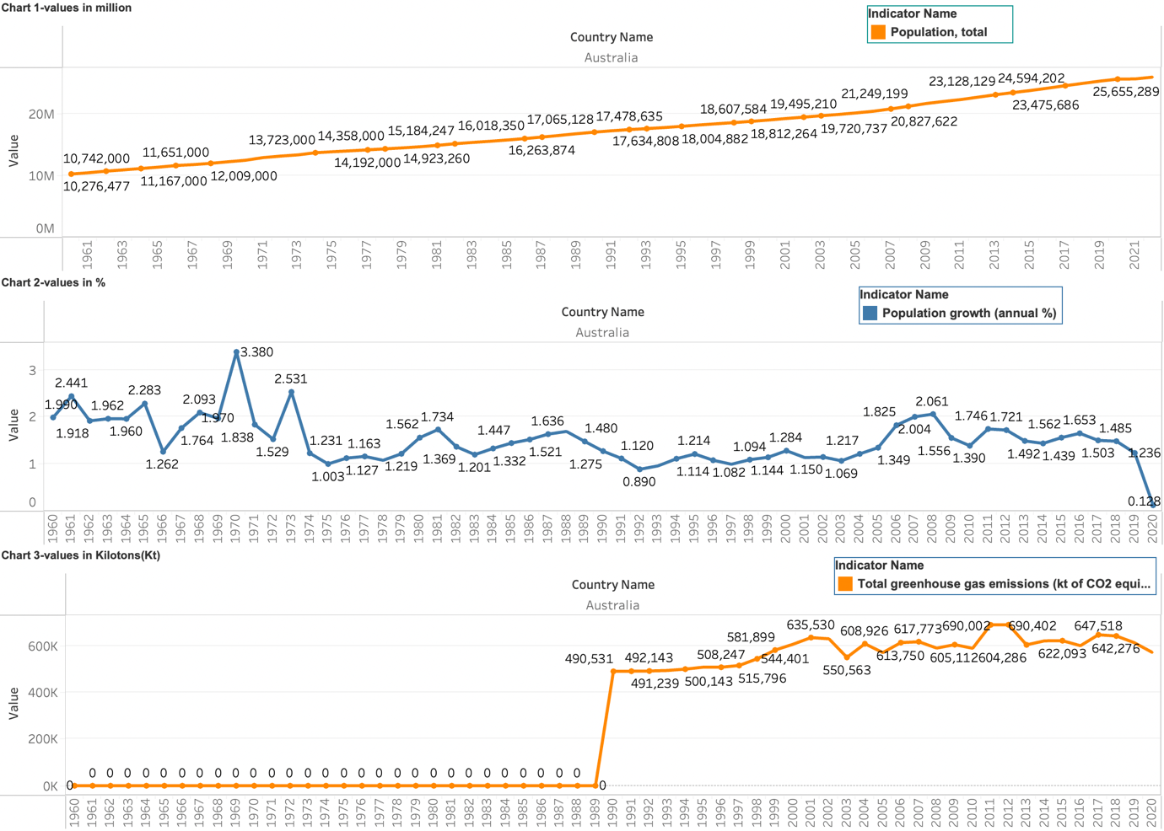
Australia findings (environment)
Australia's total greenhouse emissions have slightly increased from 1990 to 2022 due to population increase.
Unlike the UK, Australia has not set any specific emissions goal. As a result, Australia's CO2 emission is also increasing with the increase in population.
However, the dampening of emission increase is primarily due to improvements in the efficiency of various devices used across different industrial and economic sectors.
Source: Created from Tableau & sourced from the World Bank (Total greenhouse gas emissions (kt of CO2 equivalent), 2023).

Slide 27
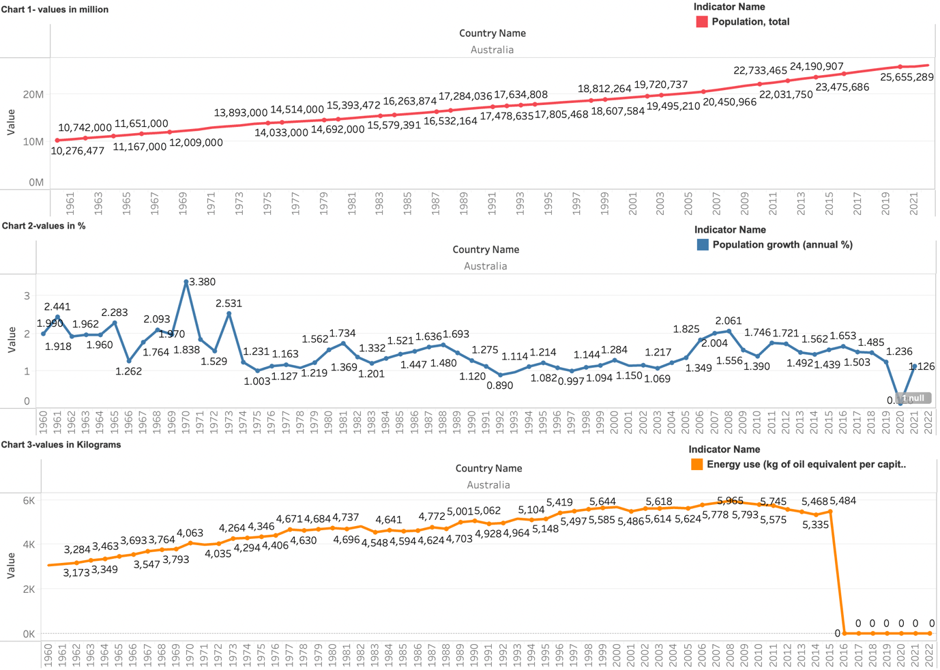
Australia findings (environment)
Industrialisation and non-renewable energy use increase CO2 emissions, while renewable energy use, financial development, and automation reduce CO2 emissions in Australia (Rahman & Alam,2022).
A study used data from 1975 to 2018 and found that Australia increased oil and coal use while decreasing gas and electricity use (Munir & Riaz, 2020).
Created from Tableau & sourced from the World Bank (Energy use (kg of oil equivalent per capita), 2014).

Slide 28
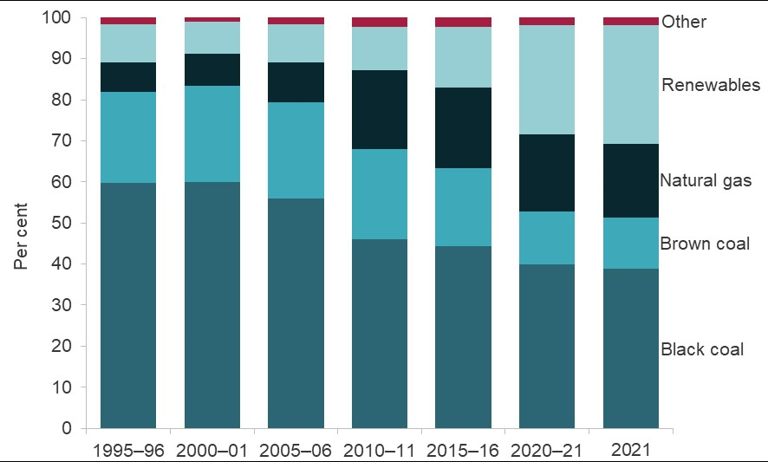
Australia findings (environment)
In 1995, around 90% of energy in Australia was generated using fossil fuels; however, this number has gone down to 71%. This would also reflect why the emission is not constant with population growth.
Energy Mix in Australia 1995 to 2021 (Gov.AU, 2021).

Slide 29
External factor
Paris Climate Agreement targets, as Australia's current target of a 26-28% reduction by 2030 is inadequate (Bourne et al., 2018). Climate change authority suggests that by 2030, Australia should aim for 45-65% emissions, with zero net emissions before 2050(Bourne et al., 2018).
In Queensland, Australia, the livestock sector alone is responsible for 70% of emissions (Panchasara et al., 2021).
Several studies have consistently found no technical barriers to Australia achieving secure, reliable power from a high proportion of renewable electricity (Bourne et al., 2018).
GHG emissions from housing are underestimated by 60% (Schmidt et al., 2020).
Due to packaging materials, online food delivery services in Australia produce 0.15 to 0.29 kg CO2e of greenhouse gas emissions per order (Arunan & Crawford, 2021). The emissions are predicted to increase by 132% by 2024 (Arunan & Crawford, 2021).

Slide 30
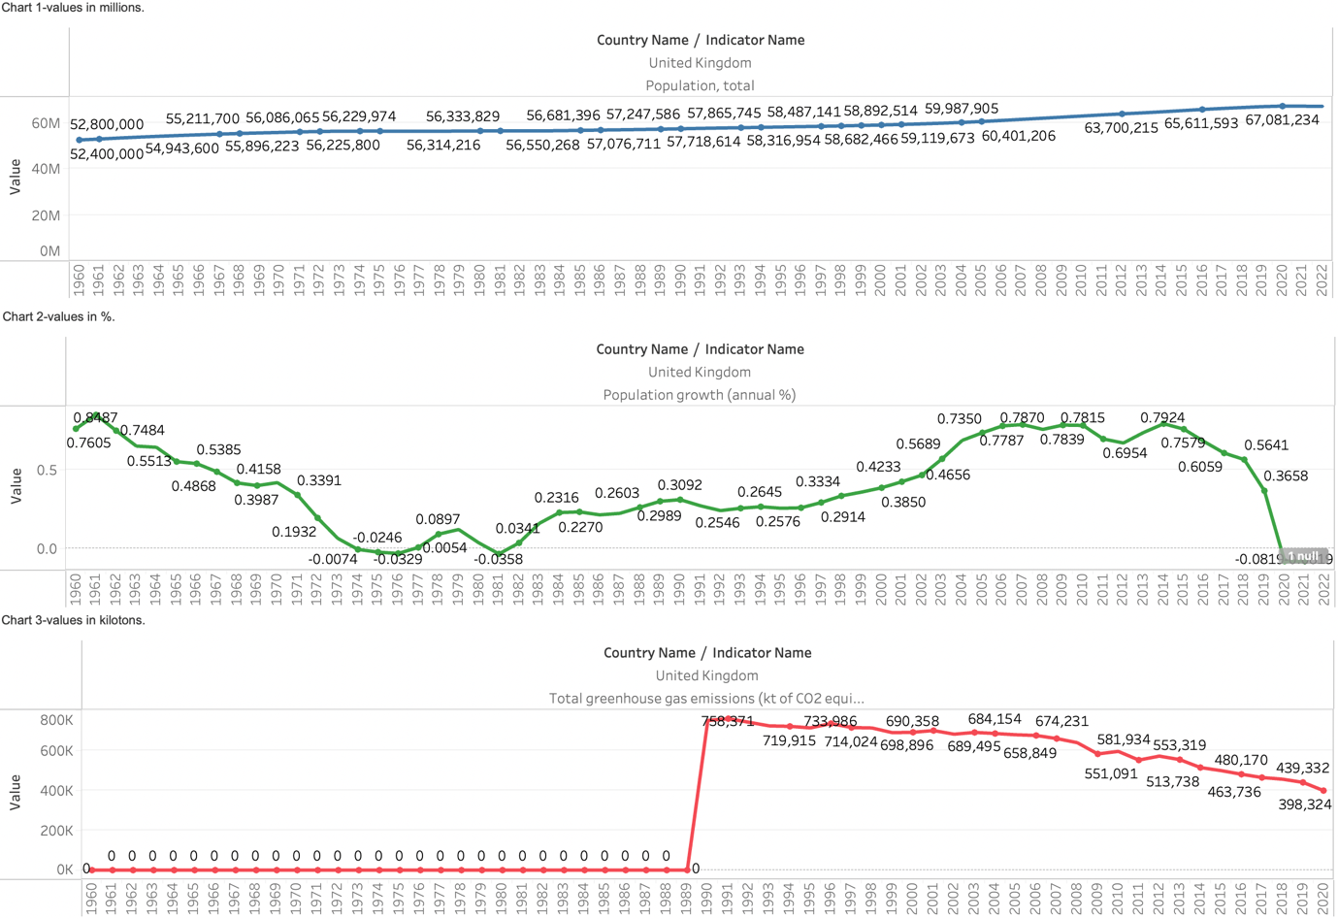
Uk findings(environmental)
The UK's CO2 emissions have decreased by over 52% between 1990 and 2022, despite a slight population growth. The decline is mainly attributed to the increase in reliance on renewable energy.
Source: Created from Tableau & sourced from the World Bank (Total greenhouse gas emissions (kt of CO2 equivalent), 2023).

Slide 31
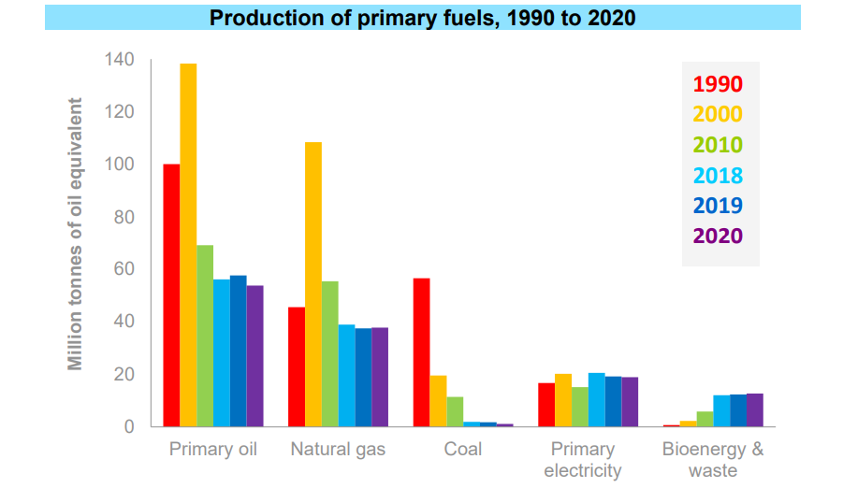
Uk findings (environmental)
Since 1990, the use of coal and oil has significantly decreased in the UK. In 1990, 56.4 million tonnes of oil equivalent coal were used, while in 2022, only 1.2 million tonnes of oil equivalent were used. The main reason for the UK's declining emissions is the change in energy sources.
Energy Sources in the UK in 1990, 2000, 2010, 2018, 2019, and 2020 (UKGOV,2021).

Slide 32
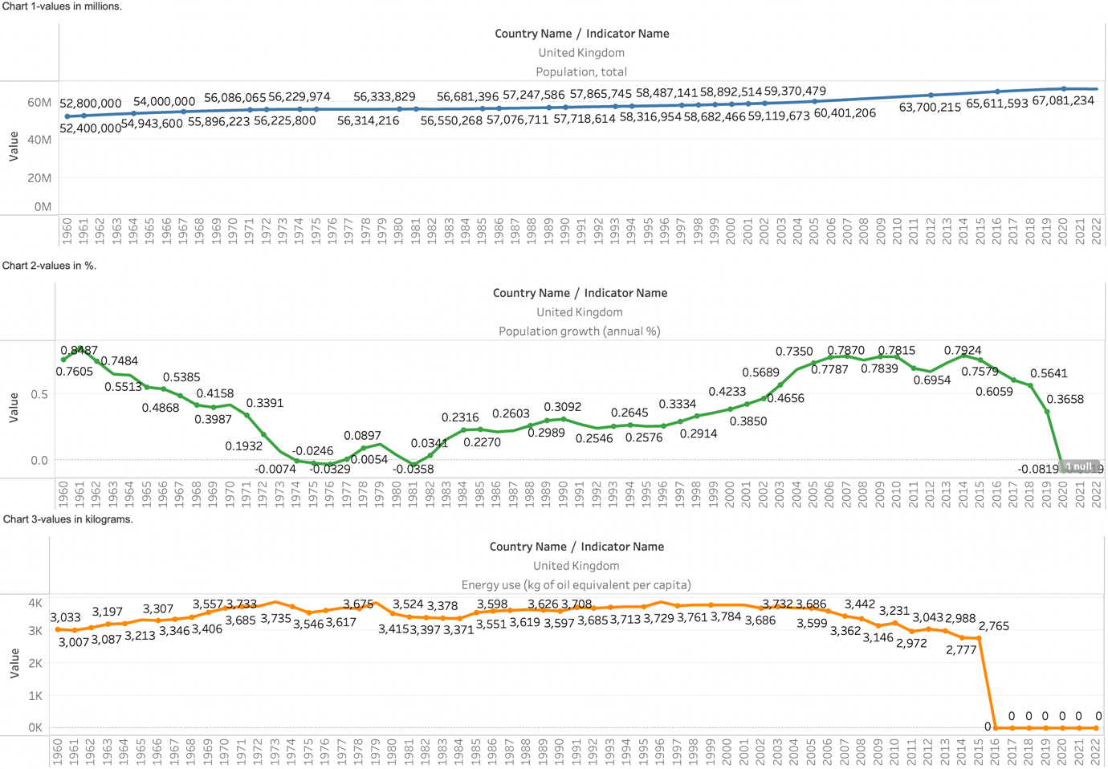
Uk findings (environmental)
When the annual population growth increases the energy use per capita decreases and vice versa which indicates that population growth has no significant impact on energy use per capita in the UK.
Created from Tableau & sourced from the World Bank (Energy use (kg of oil equivalent per capita), 2014).

Slide 33
External factors env UK.
The Food Climate Research Network (FCRN) published a report estimating that food consumption in the UK accounts for 19% of all greenhouse gas emissions generated through goods and services (Audsley et al., 2010).
Greenhouse gas emissions from personal transport in the UK are increasing, Car and air travel contribute the most to emissions, while land-based public transport has minimal impact. 43% of emissions are emitted by the top 10% , where income, economic activity, age, household structure, and car availability significantly affect emissions levels (Brand and Boardman, 2008).

Slide 34
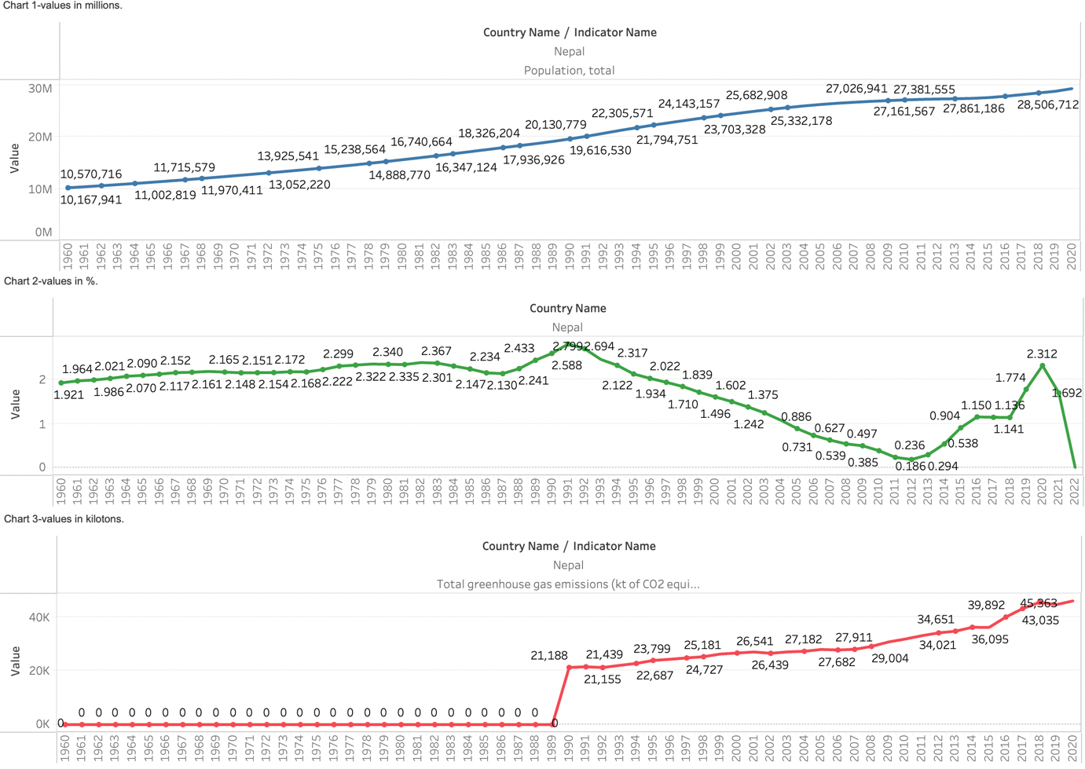
Nepal findings (environmental)
Nepal's CO2 emission trend has been coinciding with population growth since 1990. The total CO2 emission has increased by 49%, while the population has grown by about 68%. This is because Nepal still heavily relies on biomass, and the development in the renewable energy sector needs to be more significant to achieve the trend line of the UK or Australia. Therefore, the surge in CO2 emissions in Nepal directly results from the population increase.
Source: Created from Tableau & sourced from the World Bank (Total greenhouse gas emissions (kt of CO2 equivalent), 2023).

Slide 35
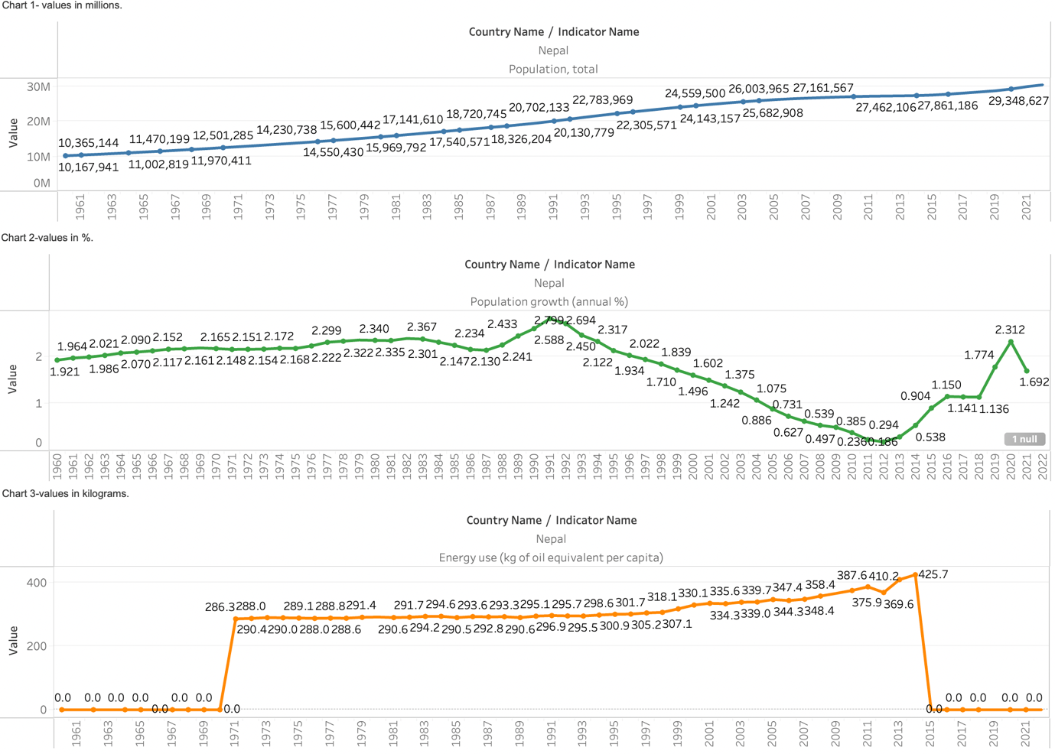
Nepal findings (environmental)
A positive correlation exists between population growth and energy use. As the population grows, energy consumption per capita also increases over time, thereby negatively impacting energy sustainability.
Created from Tableau & sourced from the World Bank (Energy use (kg of oil equivalent per capita), 2014).

Slide 36
Nepal’s env external factors
a strong positive correlation between carbon dioxide emissions and fossil fuel energy consumption over the long term (Regmi & Rehman, 2021).
A study on renewable energy in Nepal revealed that 90% of energy consumption is used for residential purposes, while 3% is used for industrial, 5% for transport, and 1% for commercial and agricultural purposes (K.C. et al., 2011).
Nepal's primary commercial fuels, petroleum and coal, are entirely imported, leading to a growing trade deficit. The shift in fuel consumption could be more sustainable due to high demand and inadequate domestic supply, resulting in importing energy from India (Sanjel et al., 2022).

Slide 37
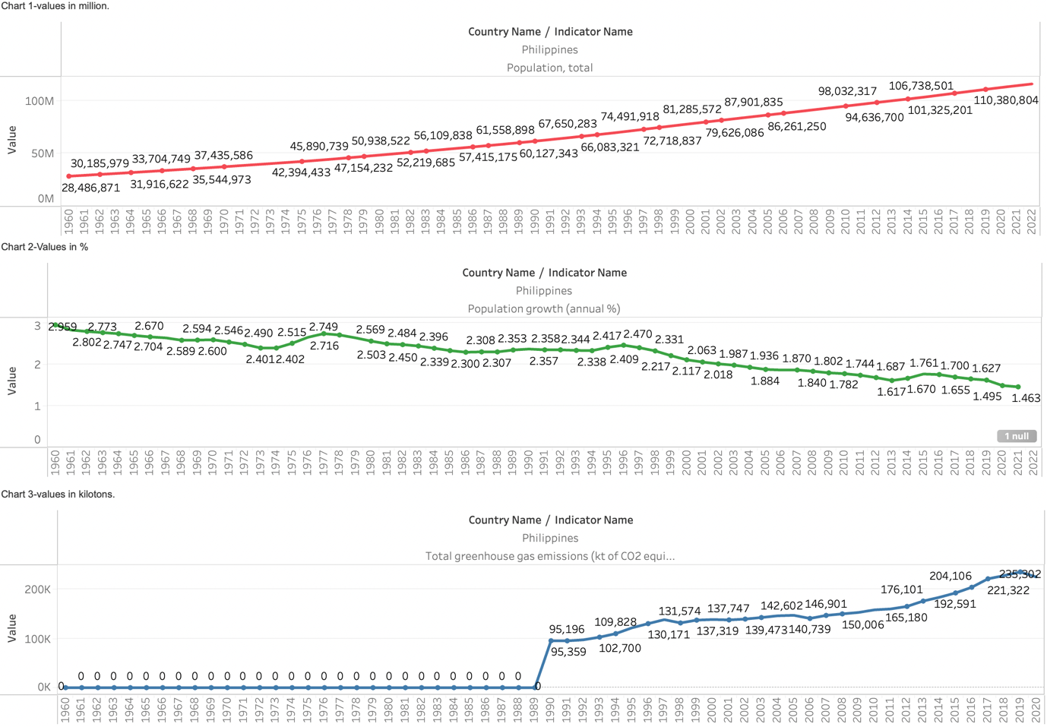
Philippines (environmental)
From 1990 to 2022, the population of the Philippines has grown by 54% while the CO2 emissions in the same period have increased by 43%. just like Nepal, the Philippines also heavily relies on biomass for energy. Resulting in an increase in emissions due to demand caused by the population growth. Like in Nepal, despite government efforts, there hasn’t been any significant growth in renewable energy sectors (Brahim, 2014).
Source: Created from Tableau & sourced from the World Bank (Total greenhouse gas emissions (kt of CO2 equivalent), 2023).

Slide 38
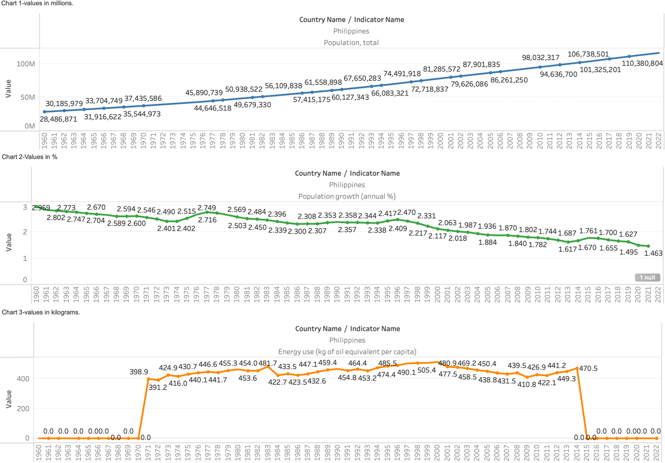
Philippines (environmental)
While the annual population growth had decreased the opposite has occurred where the energy use per capita has increased this suggests that other factors like the economy, war, diseases, etc., might have affected the fluctuating patterns of energy use per capita.
Created from Tableau & sourced from the World Bank (Energy use (kg of oil equivalent per capita), 2014).

Slide 39
Philippine's env external factors
Rice is widely grown in Asia, leaving behind significant straw residue. The Straw-to-Grain Ratio estimates the amount of rice straw produced. Over 10 million tons of rice straw residue are created annually in the Philippines, with 95% being burned in open fields, causing greenhouse gas emissions (Gadde et al., 2009).
Economic growth and higher living standards negatively impact emissions, while inconsistent energy structures harm a country's emissions performance (Sumabat et al., 2016).
Economic activity and energy intensity offset each other's contribution to CO2 emissions (Sumabat et al., 2016).
1% increase in economic growth, urbanisation, industrialisation, and tourism will result in a 0.16%, 1.25%, 0.06%, and 0.02% increase in CO2 emissions in the Philippines, respectively (Raihan, 2023).

Slide 40
Lessons Learned
Population seems to impact Sustainability Performance More in Developed Countries than in developing countries.
The main reason for this is the financial prowess of developed countries.

Slide 41
Gaps
Limited components studied.
More parameters need to be studied to understand the detailed correlation between population and sustainability.
Further research can be conducted to justify the lack of a link between population and Socioeconomic aspects in the Philippines, Nepal, the UK, and Australia.

Slide 42
Conclusion
Population does not necessarily influence the Socio-Economic aspect of Sustainability and is mainly driven by external factors. This was evident in both developed and developing nations studied in this dissertation.
In the case of emissions, there doesn’t seem to be a direct correlation with population in Developed nations (UK and Australia).
This is primarily due to changes in the Energy mix as these countries were increasing their reliance on Eco-friendly energies.
Both Australia and the UK are heavily industrialised nations with highly developed infrastructures. Switching to renewables and improving the efficiency of devices significantly lowered the energy demand, negating the increase in GHG emissions caused by population growth.
The impact of population growth on emissions can be negated with the development of low-carbon technologies. However, not all countries have the financial capacity to introduce the technology to offset this impact.
Overall, Population growth in developing countries has an enormous sustainability impact on developing than developed countries

Slide 43
Thank you
Samrat rai(21025221).

Slide 44
references
Allard, S.W. and Roth, B., 2010. Strained Suburbs. Brookings Institute Metropolitan Opportunity Series.
Arunan, I. and Crawford, R.H., 2021. Greenhouse gas emissions associated with food packaging for online food delivery services in Australia. Resources, Conservation and Recycling, 168, p.105299.
Audsley, E., Brander, M., Chatterton, J.C., Murphy-Bokern, D., Webster, C. and Williams, A.G., 2010. How low can we go? An assessment of greenhouse gas emissions from the UK food system and the scope reduction by 2050. Report for the WWF and Food Climate Research Network.
Australian electricity generation - fuel mix (2023) energy.gov.eu. Available at: https://www.energy.gov.au/data/australian-electricity-generation-fuel-mix (Accessed: 07 September 2023).
Bourne, G., Stock, A., Steffen, W., Stock, P. and Brailsford, L., 2018. Australia's rising greenhouse gas emissions.
Brahim, S.P., 2014. Renewable energy and energy security in the Philippines. Energy Procedia, 52, pp.480-486.
Brand, C. and Boardman, B., 2008. Taming of the few—the unequal distribution of greenhouse gas emissions from personal travel in the UK. Energy Policy, 36(1), pp.224-238.
Brown, J. and Loosemore, M., 2015. Behavioural factors influencing corrupt action in the Australian construction industry. Engineering, Construction and Architectural Management, 22(4), pp.372-389.
Cole, M., 2008. Sociology contra government? The contest for the meaning of unemployment in UK policy debates. Work, employment and society, 22(1), pp.27-43.
Collegenp (2023) Infrastructure Development and access to basic services in Nepal, CollegeNp.com. Available at: https://www.collegenp.com/article/infrastructure-development-and-access-to-basic-services-in-nepal/ (Accessed: 31 July 2023).
CORTIS, N., BLAXLAND, M. and CHARLESWORTH, S., 2023. Care theft: Family impacts of employer control in Australia's retail industry. Critical Social Policy, p.02610183231185766.
Davidson, M.C., Timo, N. and Wang, Y., 2010. How much does labour turnover cost? A case study of Australian four‐and five‐star hotels. International journal of contemporary hospitality management, 22(4), pp.451-466.
Energy use (kg of oil equivalent per capita) (2014) data.worldbank.org. Available at: https://data.worldbank.org/indicator/EG.USE.PCAP.KG.OE (Accessed: 14 August 2023).
Fulford, R. and Standing, C., 2014. Construction industry productivity and the potential for collaborative practice. International journal of project management, 32(2), pp.315-326.
Gadde, B., Menke, C. and Wassmann, R., 2009. Rice straw as a renewable energy source in India, Thailand, and the Philippines: Overall potential and limitations for energy contribution and greenhouse gas mitigation. Biomass and bioenergy, 33(11), pp.1532-154

Slide 45
REFRENCES
House, G., 2020. Postgraduate education in the UK. Higher Education Policy Institute.
Industry (including construction), value added (% of GDP) (2023) data.worldbank.org. Available at: https://data.worldbank.org/indicator/NV.IND.TOTL.ZS (Accessed: 14 August 2023).
Ladbrook, D.A., 1988. Why are crime rates higher in urban than in rural areas?—Evidence from Japan. Australian & New Zealand Journal of Criminology, 21(2), pp.81-103.
Lim, J., Bogossian, F. and Ahern, K., 2010. Stress and coping in Australian nurses: a systematic review. International nursing review, 57(1), pp.22-31.
Mitra, R.M. (2013) Leveraging Service Sector Growth in the Philippines, www.adb.org. Available at: https://www.adb.org/sites/default/files/publication/30385/ewp-366.pdf (Accessed: 13 August 2023).
Munir, K. and Riaz, N., 2020. Asymmetric impact of energy consumption on environmental degradation: evidence from Australia, China, and USA. Environmental Science and Pollution Research, 27(11), pp.11749-11759.
Ofreneo, R.E., 2015. Growth and employment in de-industrializing Philippines. Journal of the Asia Pacific Economy, 20(1), pp.111-129.
Panzone, L.A., Larcom, S. and She, P.W., 2021. Estimating the impact of the first COVID-19 lockdown on UK food retailers and the restaurant sector. Global Food Security, 28, p.100495.
Rahman, M.M. and Alam, K., 2022. Impact of industrialization and non-renewable energy on environmental pollution in Australia: Do renewable energy and financial development play a mitigating role?. Renewable Energy, 195, pp.203-213.
Reidhead, C., 2020. Impact of organizational culture on employee satisfaction: A case of Hilton hotel, United Kingdom. Journal of Economics and Business, 3(1).
Robinson, D. (2023) UK manufacturers’ sales by product: 2022 results, ons.gov.uk. Available at: https://www.ons.gov.uk/businessindustryandtrade/manufacturingandproductionindustry/bulletins/ukmanufacturerssalesbyproductprodcom/2022results (Accessed: 18 August 2023).

Slide 46
references
House, G., 2020. Postgraduate education in the UK. Higher Education Policy Institute.
Industry (including construction), value added (% of GDP) (2023) data.worldbank.org. Available at: https://data.worldbank.org/indicator/NV.IND.TOTL.ZS (Accessed: 14 August 2023).
K.C., S. et al. (2011) Current status of renewable energy in Nepal: Opportunities and challenges, Renewable and Sustainable Energy Reviews. Available at: https://www.sciencedirect.com/science/article/pii/S1364032111002619?casa_token=PYqdF6WVzvYAAAAA%3ABHMWDE0y2Cs0wkL7y78O-bykNRrx8cUpYD0Gc5yHfiWZqss-SVHO9_izks0V7PJMSsuaymhjBA (Accessed: 03 August 2023).
Ladbrook, D.A., 1988. Why are crime rates higher in urban than in rural areas?—Evidence from Japan. Australian & New Zealand Journal of Criminology, 21(2), pp.81-103.
Lim, J., Bogossian, F. and Ahern, K., 2010. Stress and coping in Australian nurses: a systematic review. International nursing review, 57(1), pp.22-31.
Mitra, R.M. (2013) Leveraging Service Sector Growth in the Philippines, www.adb.org. Available at: https://www.adb.org/sites/default/files/publication/30385/ewp-366.pdf (Accessed: 13 August 2023).
Munir, K. and Riaz, N., 2020. Asymmetric impact of energy consumption on environmental degradation: evidence from Australia, China, and USA. Environmental Science and Pollution Research, 27(11), pp.11749-11759.
Ofreneo, R.E., 2015. Growth and employment in de-industrializing Philippines. Journal of the Asia Pacific Economy, 20(1), pp.111-129.
Panchasara, H., Samrat, N.H. and Islam, N., 2021. Greenhouse gas emissions trends and mitigation measures in Australian agriculture sector—A review. Agriculture, 11(2), p.85.
Panzone, L.A., Larcom, S. and She, P.W., 2021. Estimating the impact of the first COVID-19 lockdown on UK food retailers and the restaurant sector. Global Food Security, 28, p.100495.
Rahman, M.M. and Alam, K., 2022. Impact of industrialization and non-renewable energy on environmental pollution in Australia: Do renewable energy and financial development play a mitigating role?. Renewable Energy, 195, pp.203-213.
Raihan, A., 2023. The dynamic nexus between economic growth, renewable energy use, urbanization, industrialization, tourism, agricultural productivity, forest area, and carbon dioxide emissions in the Philippines. Energy Nexus, 9, p.100180.
Regmi, K. and Rehman, A. (2021) Do carbon emissions impact Nepal’s population growth, energy utilization, and economic progress? evidence from long- and short-run analyses - environmental science and Pollution Research, SpringerLink. Available at: https://link.springer.com/article/10.1007/s11356-021-14546-6 (Accessed: 02 August 2023).

Slide 47
references
Reidhead, C., 2020. Impact of organizational culture on employee satisfaction: A case of Hilton hotel, United Kingdom. Journal of Economics and Business, 3(1).
Robinson, D. (2023) UK manufacturers’ sales by product: 2022 results, ons.gov.uk. Available at: https://www.ons.gov.uk/businessindustryandtrade/manufacturingandproductionindustry/bulletins/ukmanufacturerssalesbyproductprodcom/2022results (Accessed: 18 August 2023).
Safdie, S. (2023) What are the Three Pillars of Sustainable Development?, greenly. earth. Available at: https://greenly.earth/en-gb/blog/company-guide/3-pillars-of-sustainable-development (Accessed: 12 September 2023).
Sanjel, N. et al. (2022) Nepal Energy Outlook 2022, EnergizeNepal – School of Engineering, Kathmandu University. Available at: https://energizenepal.ku.edu.np/wp-content/uploads/2022/08/NEO-2022-Final.pdf (Accessed: 04 August 2023).
Schmidt, M., Crawford, R.H. and Warren-Myers, G., 2020. Quantifying Australia’s life cycle greenhouse gas emissions for new homes. Energy and Buildings, 224, p.110287.
Services, value added (% of GDP) (2023) data.worldbank.org. Available at: https://data.worldbank.org/indicator/NV.SRV.TOTL.ZS (Accessed: 14 August 2023).
Shah, T.I., Bell, S. and Wilson, K., 2016. Spatial accessibility to health care services: Identifying under-serviced neighborhoods in Canadian urban areas. PloS one, 11(12), p.e0168208.
Shooshtarian, S., Maqsood, T., Wong, P.S., Khalfan, M. and Yang, R.J., 2021. Extended producer responsibility in the Australian construction industry. Sustainability, 13(2), p.620.
Simon (2022) The three pillars of sustainability explained, sustainability-success.com. Available at: https://sustainability-success.com/three-pillars-of-sustainability/ (Accessed: 12 September 2023).
Sumabat, A.K., Lopez, N.S., Yu, K.D., Hao, H., Li, R., Geng, Y. and Chiu, A.S., 2016. Decomposition analysis of Philippine CO2 emissions from fuel combustion and electricity generation. Applied Energy, 164, pp.795-804.
The top 10 largest economies in the world in 2023 (2023) forbesindia.com. Available at: https://www.forbesindia.com/article/explainers/top-10-largest-economies-in-the-world/86159/1 (Accessed: 15 September 2023).
Total greenhouse gas emissions (kt of CO2 equivalent) (2023) data.worldbank.org. Available at: https://data.worldbank.org/indicator/EN.ATM.GHGT.KT.CE (Accessed: 14 August 2023).
UKGOV (2021) UK energy in brief 2021 - GOV.UK. Available at: https://assets.publishing.service.gov.uk/government/uploads/system/uploads/attachment_data/file/1032260/UK_Energy_in_Brief_2021.pdf (Accessed: 06 September 2023).
Unemployment, total (% of total labor force) (modeled ILO estimate) (2023) data.worldbank.org. Available at: https://data.worldbank.org/indicator/SL.UEM.TOTL.ZS (Accessed: 14 August 2023).

